Slide 1
Population in California
Peifen Lyu
Yimeng Tan
Zhenhan Si

Slide 2
Population in California
Why do we study population?
human resource development
housing, health and education facilities
management of key natural resources
Population factors are an essential part of any national development strategies.

Slide 3
Population in California
How do we study population?
Analyze current population in CA
Predict future population in CA

Slide 4
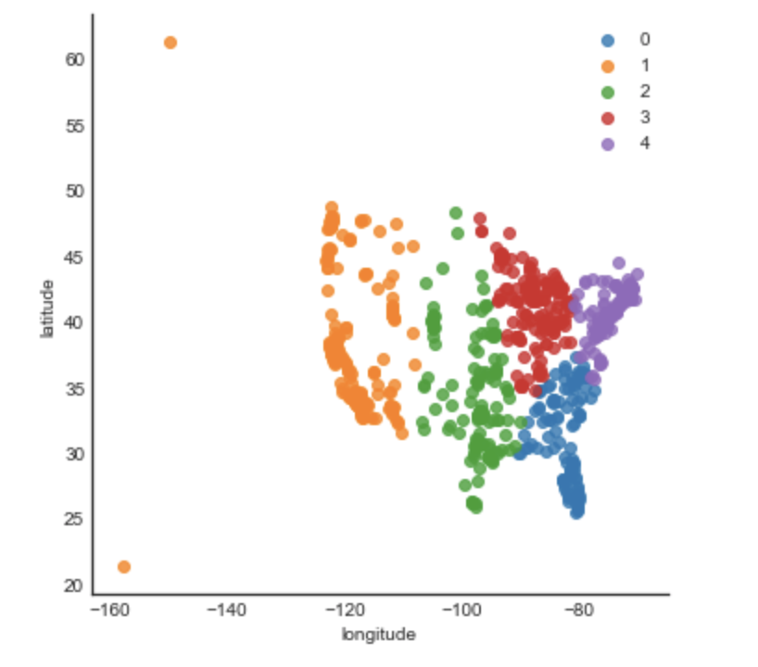
Part 1: Population Distribution in US: Machine Learning
Kmean algorithm (an unsupervised machine learning)
Divide the US into 5 parts:
Orange -> Pacific;
Green -> Mountain;
Red -> Midwest;
Blue -> Southeast;
Purple -> Northeast
SAME AS WE DESCREIBED IN REAL LIFE

Slide 5
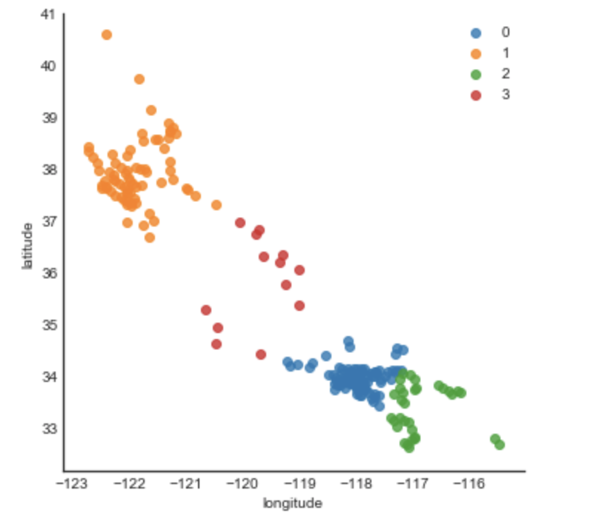
Part 2: Population Distribution in CA: Machine Learning
Divide the CA into 4 parts:
Orange -> Bay Area;
Red -> Central Valley;
Blue -> L.A. County;
Green -> South Coast
If we change the number in the function from 4 to 2, directly divide the CA in to North-CA and South-CA
DATA: webscrape Json file

Slide 6
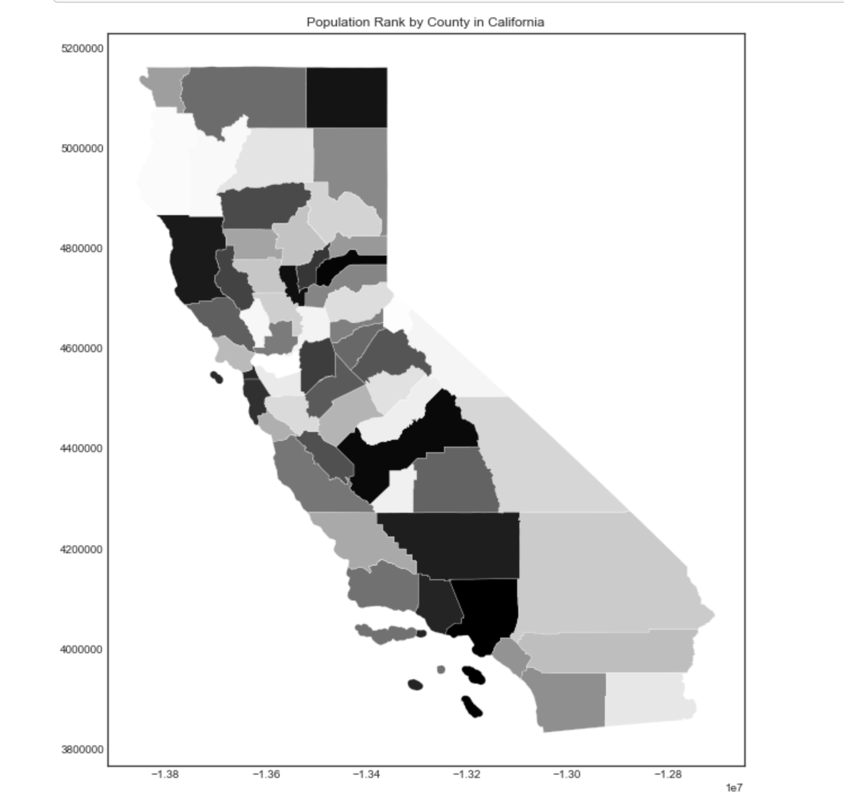
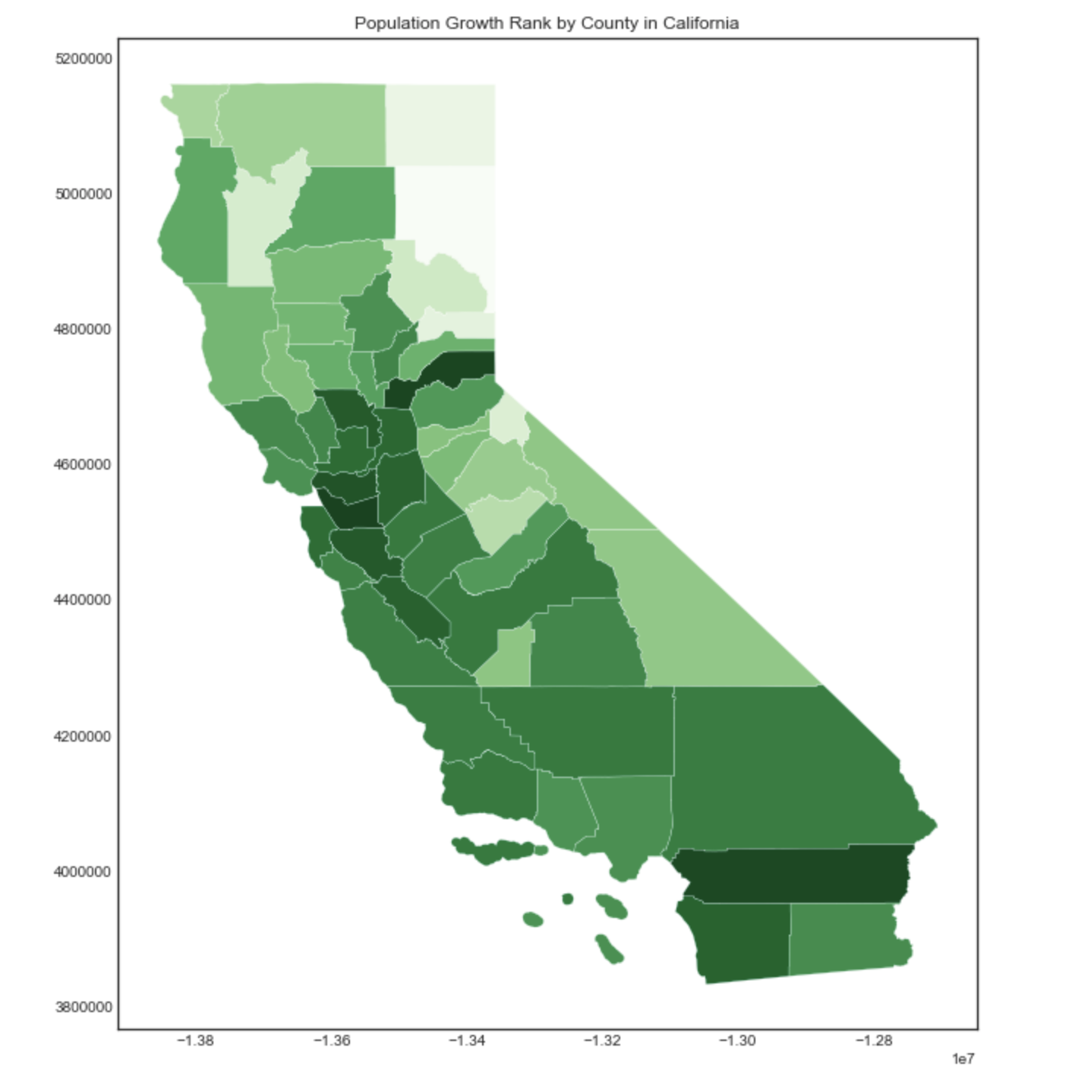
Part 2: Population Distribution in CA
Population Rank by County
Population Growth Rank by County
Data: webscrape xml : xPath

Slide 7
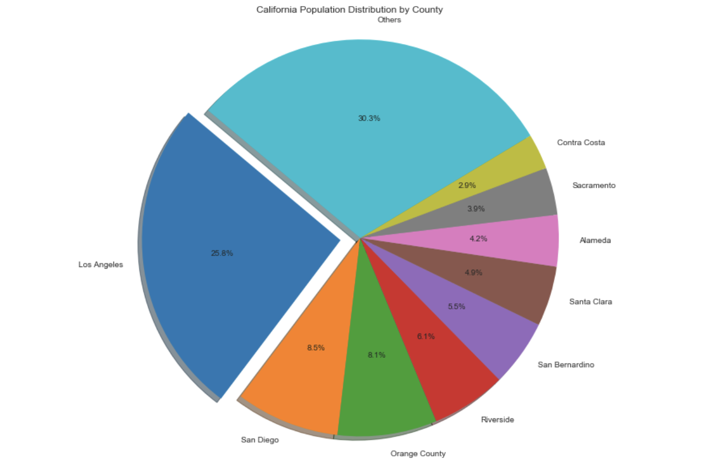
Part 2: Population Distribution in CA: Pie Chart
Data: webscrape xml : xPath
California Population Distribution by major cities

Slide 8
Part3: Influential Factors to Population in CA:
Population Density
Factors: Growth Rate, Birth Rate, Net Migration Rate, Unemployment Rate, Income Per Capita, Poverty Rate, Number of Malls, Number of College
Data Source: Federal Reserve Economic Data (API), California State Association of Counties(XML), State of California, Department of Finance(CSV), Public Policy Institute of California(CSV), Wikipedia (XML)

Slide 9
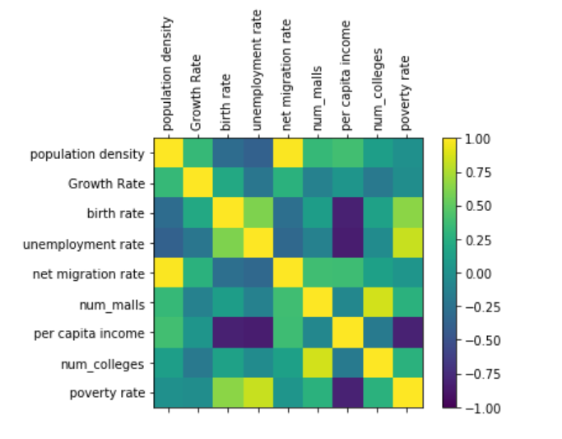
Part3: Influential Factors to Population in CA:
Extract influential factors:
We list the factors that might influence population, and then we use CORRELATION MATRIX to observe which factors are highly correlated with the population in order to extract them to build other models.

Slide 10
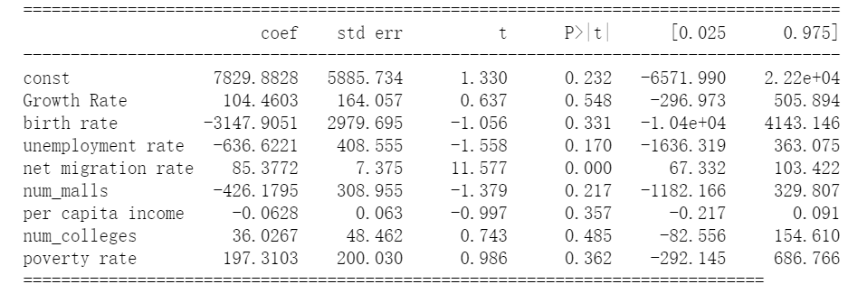
Part3: Influential Factors to Population in CA:
We use LINEAR REGRESSION MODEL to test which factors influence the population distribution the most and establish a model between population density and the selected variables

Slide 11
Part3: Influential Factors to Population in CA:

Slide 12
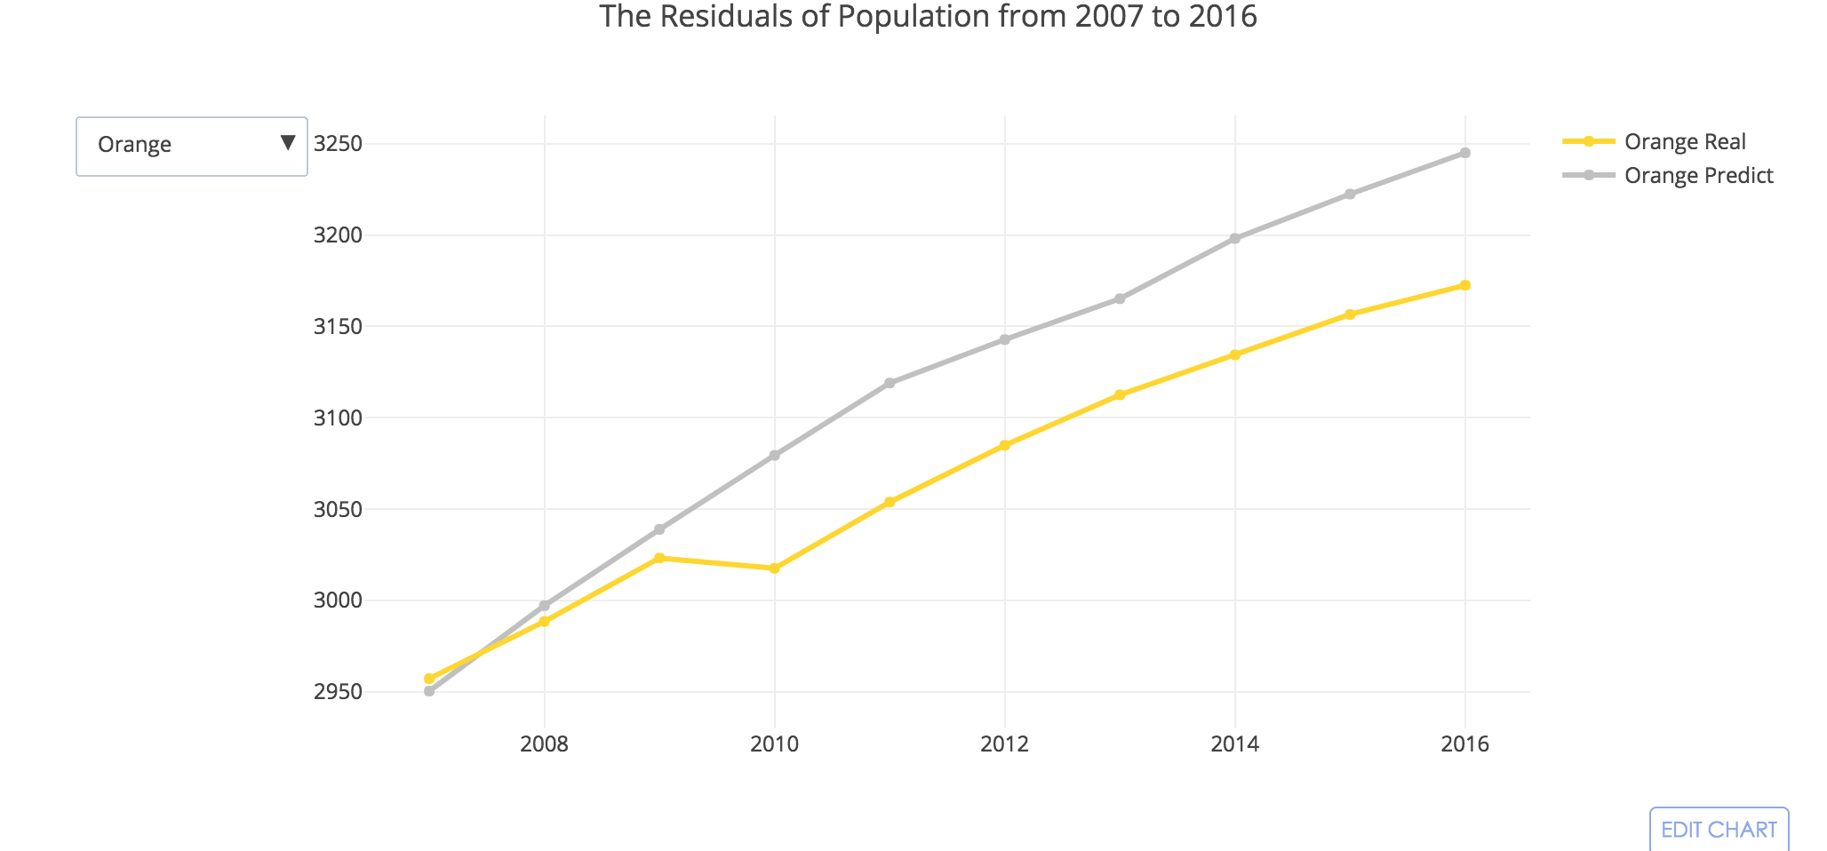
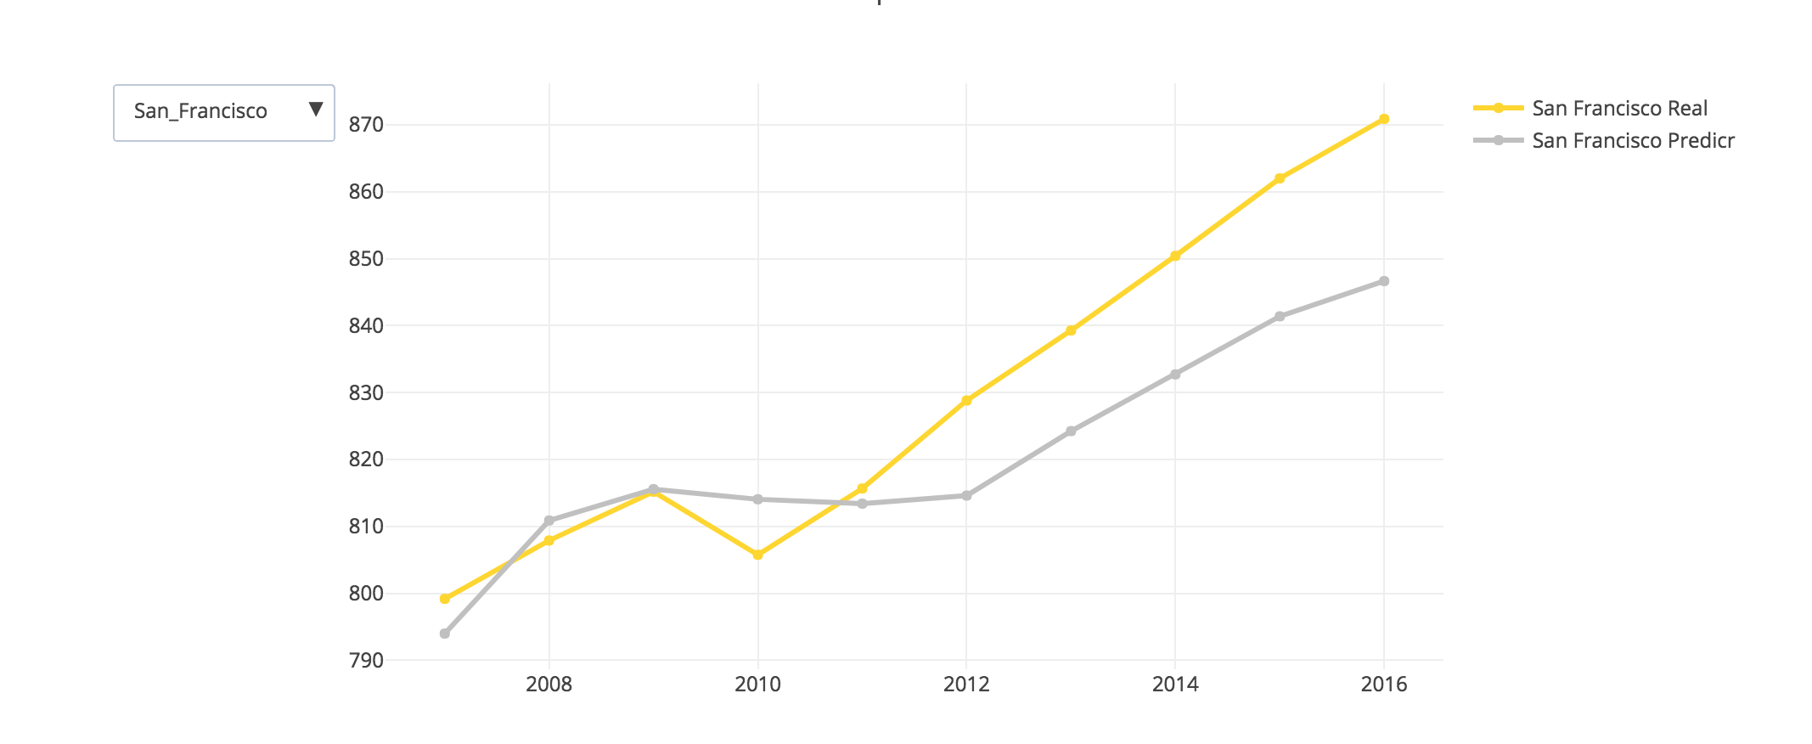
Part 4: Future Population Prediction by County: Time Series

Slide 13
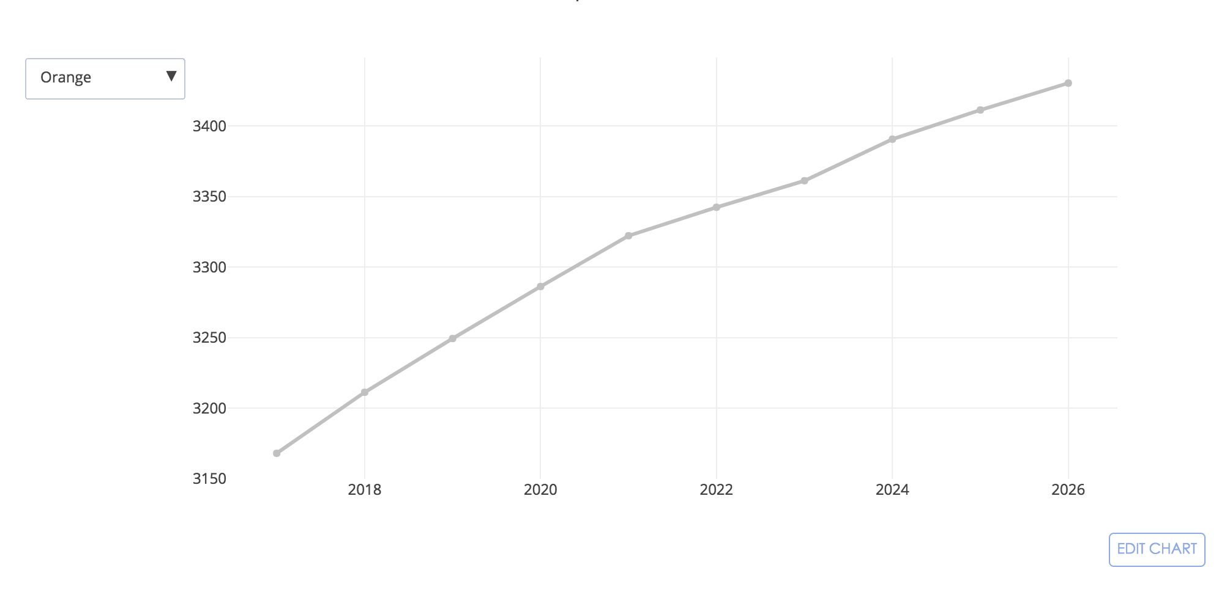
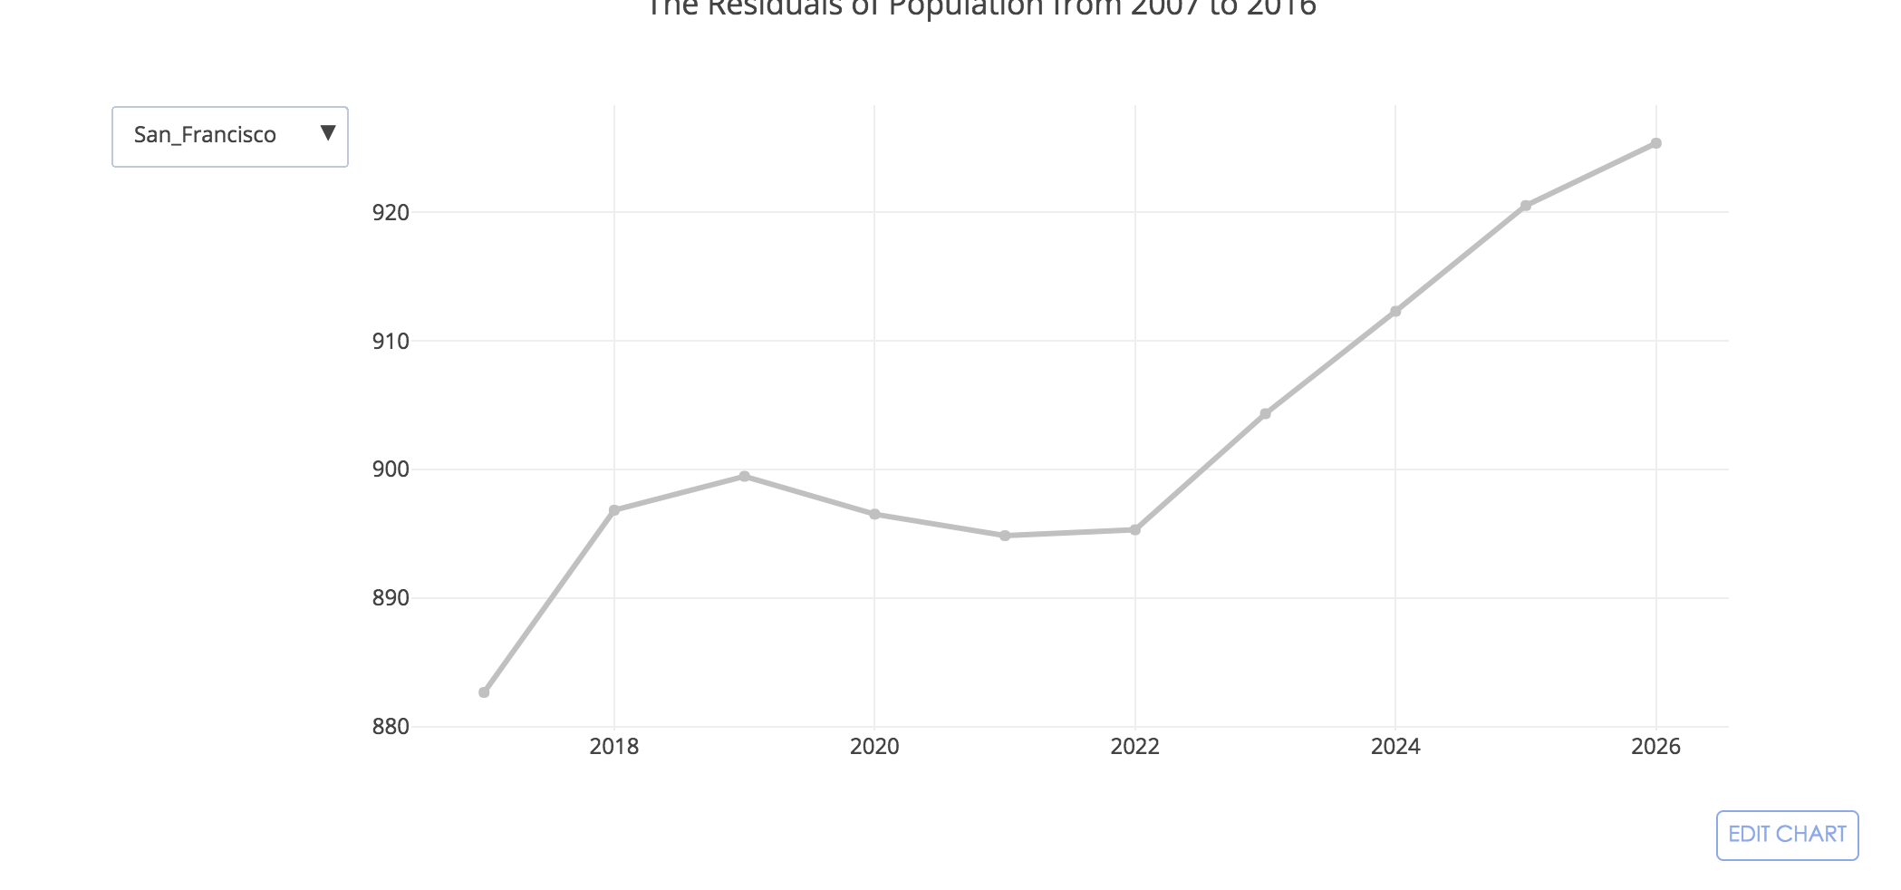
Part 4: Future Population Prediction by County: Time Series

Slide 14
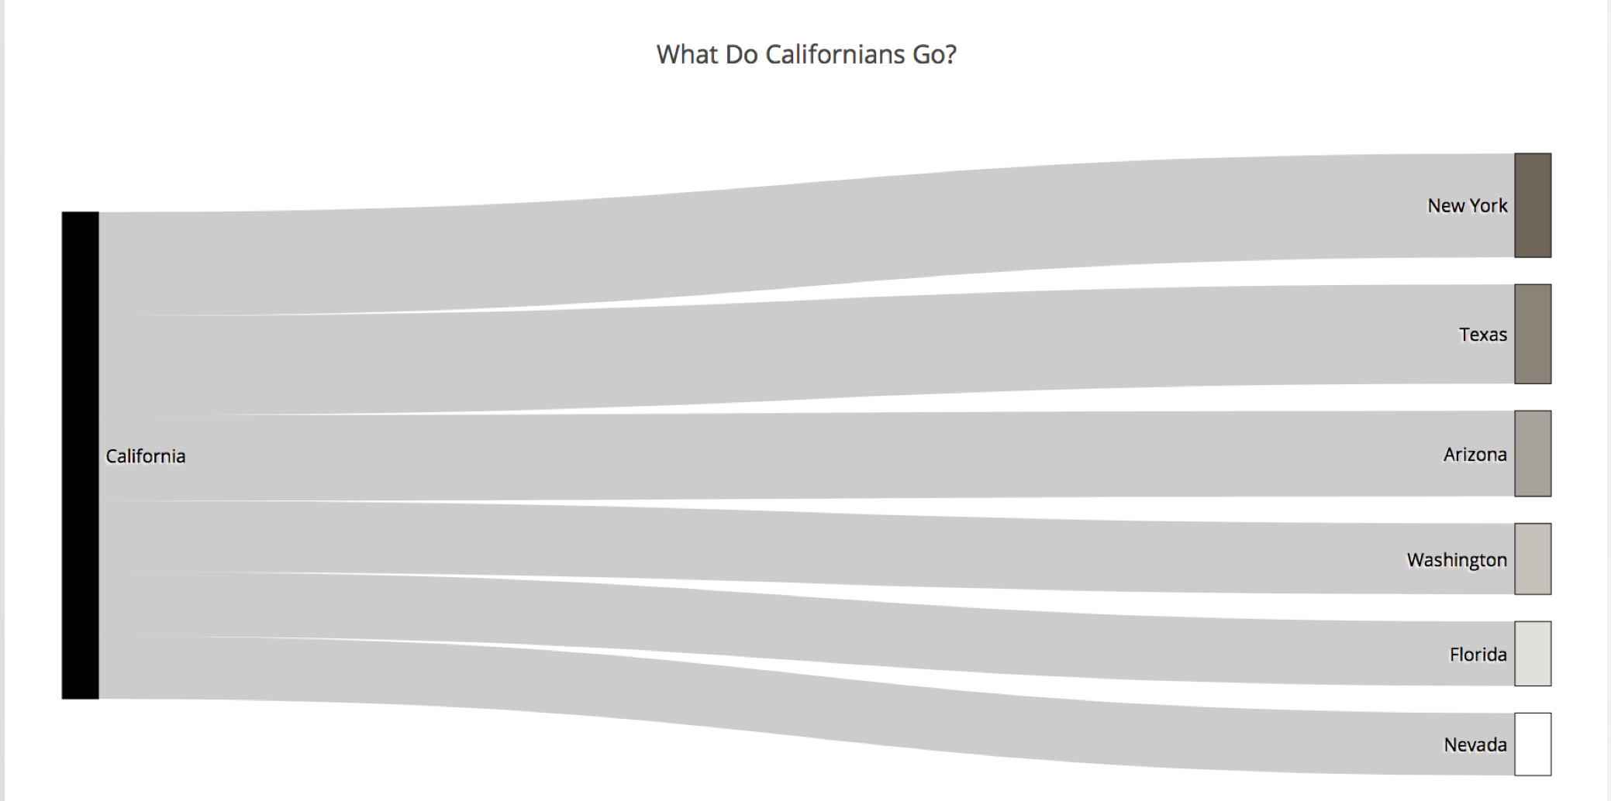
Where do Californians go?
Sankey diagram

Slide 15

Part 5: Major Topics in CA: Word Cloud
As shown, people in California care a lot of topics such as State, Climate Change, Land, etc. Additionally, “PEOPLE,” indicates that population is also a hot issue.

